Slide 1
SEO Traffic
Ting Sit
10/29/2018

Slide 2
Objective
Predict SEO visit for E-commerce business for next 12 months
Data:
Source – Adobe Analytic
Range – Jan 2016 – Sep 2018

Slide 3
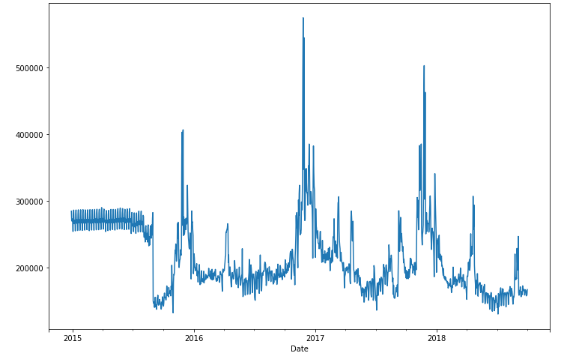
EDA

Slide 4
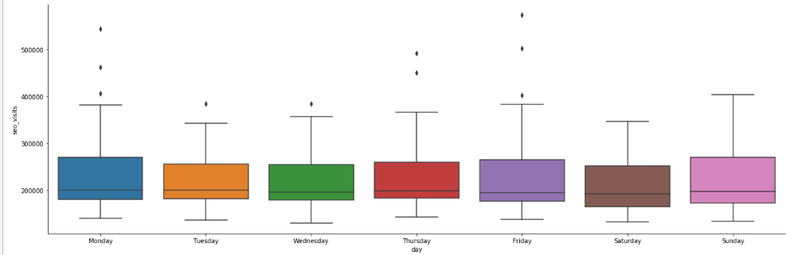
Day of Week

Slide 5
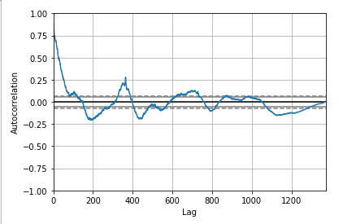
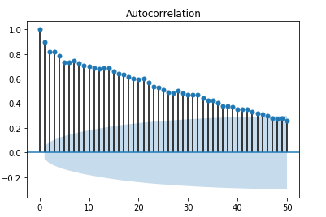
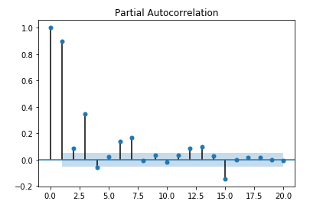
Correlation

Slide 6
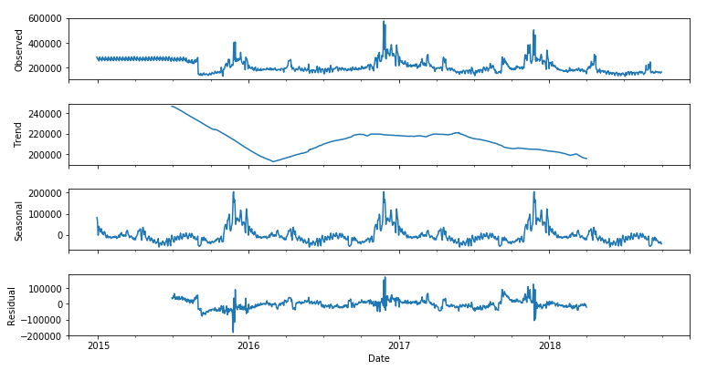
Decompose

Slide 7
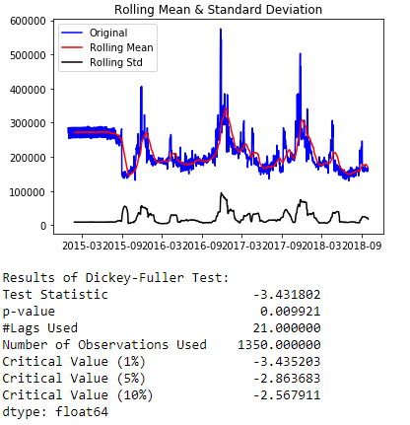
Dicky-Fuller

Slide 8

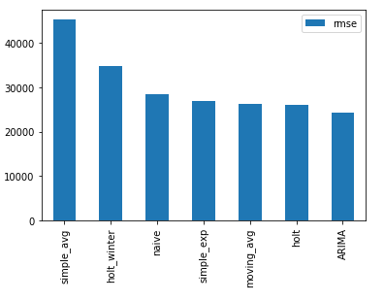
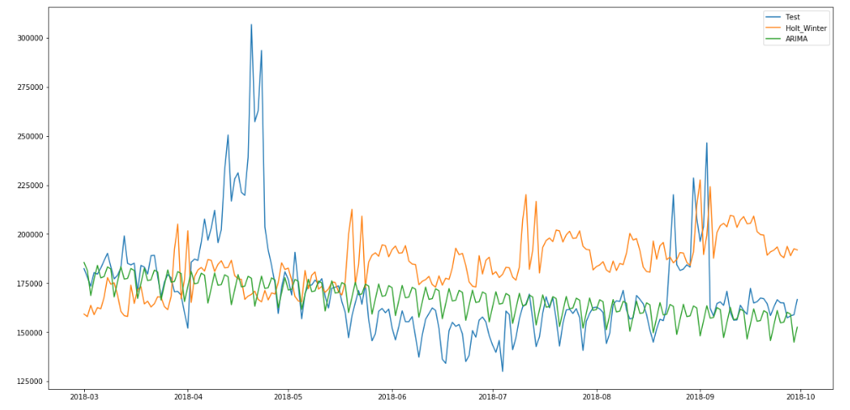
Time-Series Analysis

Slide 9
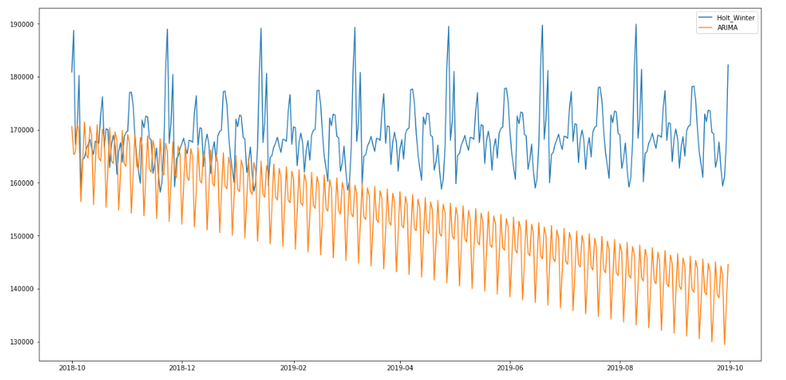
Future Predictions

Slide 10
Opportunity
Extract out significant promotional activities
Apply differencing and de-trending
Algorithms parameters fine tuning
Cannibalization from other online vehicles (e.g. media spend, email, mobile messaging)

